Slide 1
SHARK TANK ANALYSIS Insights for Future Entrepreneurs
Santosh Jayaswal

Slide 2
CONTENTS
Project Recap
Problem Statement
Process
Insights
Analysis
Summary

Slide 3
Project Recap
A popular TV show named Shark Tank where entrepreneurs come to introduce their company for raising funds in exchange for equity to investors. For analysis, I gathered a dataset from Kaggle, which contains records from the past three seasons and helped in extracting insights on average offer equity or ask amount by entrepreneurs, popular industries, and more.

Slide 4
Problem statement
Entrepreneurs need an assistance in understanding the factors that contribute to successful pitches, such as industry trends, successful deal ratio.

Slide 5
process
1
Clean Dataset -> Removed Null Rows.
2
Create Sharks Table and Merge with Fact Table
3
Perform Analysis
4
Create Dashboard
5
Share Report

Slide 6
Analysis
478
268
212
$14
4
Total Pitchers
Successful Deal
Deal on Higher Equity
Avg Ask Amount
Avg Equity Offer
Come to introduce their business.
Successfully crack the deal out of total participants.
Deal has been done more than offered equity.
Entrepreneurs asking average amount.
Entrepreneurs offering equity in against raising fund.

Slide 7
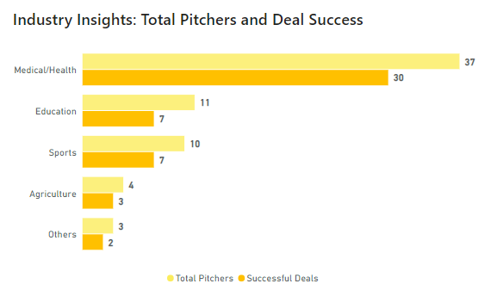
Industry Insights
Identify industries with the highest potential and maximum offers from investors.
Medical and Education sectors receive the most interest and investment from sharks.
Entrepreneurs can focus on industries that historically attract more investments, increasing their chances of securing a deal.

Slide 8
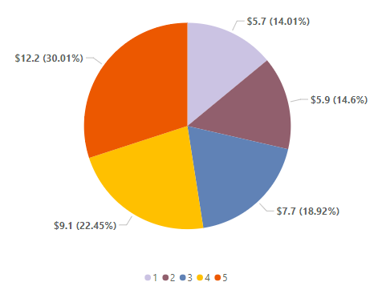
Number of Sharks
Determine the average amount offered based on the number of sharks involved in a deal.
Average investment is ₹5.7 million when single shark join, and amount is increases as more sharks join the deal.
Entrepreneurs can strategize their pitch to appeal to multiple sharks, potentially increasing the investment amount.

Slide 9
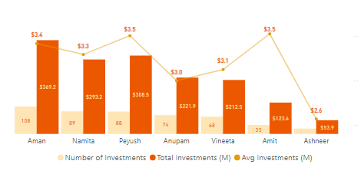
Sharks Investment
Analyze the investment patterns of individual sharks.
Aman is the top investor with 108 deals, and his total and average investment are ₹350 million and ₹3.4 million, respectively.
Entrepreneurs can strategize their pitch to appeal to multiple sharks, potentially increasing the investment amount.

Slide 10
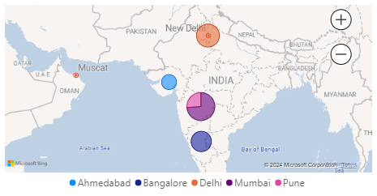
Picher’s Distribution
Highlight the top cities and states where entrepreneurs receive the highest deals.
Mumbai and Delhi are the top cities that have the highest concentration of successful pitches.
Entrepreneurs from or targeting these regions can leverage this information to their advantage, understanding that certain areas have a higher success rate.

Slide 11
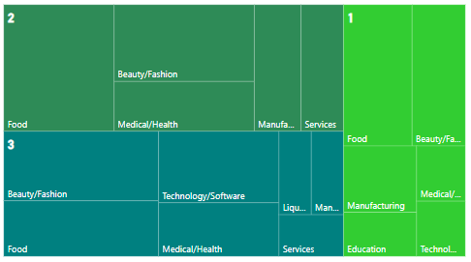
Top 5 Industry by Season
Identify the top industries receiving successful deals each season.
Beauty, Fashion, and Food are the high-performing industries and these categories consistently secure top positions across all seasons.
Entrepreneurs can gain insights into which industries are more likely to receive funding, helping them position their businesses in favorable categories.

Slide 12
Summary
Our cleaned and analyzed data, revealing that industries like Medical and Education attract the highest investments, with single sharks offering an average of ₹5.7 million and higher amounts when multiple sharks are involved.
Identified top cities like Mumbai and Delhi as leading regions for successful pitches, providing entrepreneurs with strategic locations for targeting their business pitches.
Found that Aman is the top investor, with 108 deals and a total investment of ₹350 million, helping entrepreneurs tailor their pitches to attract significant investors and maximize their chances of securing a deal.

Slide 13
THANK YOU
Santosh Jayaswal​
official.sanedu@gmail.com

